Slide 1
DATA WAREHOUSE
FudgeCorp
Urvi Mistry Madhavi Kadam Shwet Jain Parth Nikam

Slide 2
Team & Roles
Urvi Mistry : Data Warehouse Architect
Madhavi Kadam : Data Warehouse Architect
Shwet Jain : Data Warehouse Architect & Database Manager
Data Warehouse Architect - High Level Dimensioning Modeling & SSIS Integration
Parth Nikam : BI Architect

Slide 3


Company Description
FudgeMart
FudgeFlix
It is an online retail store selling goods across various categories such as electronics, sporting materials etc
It is an online blu-ray and dvd movie rental service which also provides on demand video service for users with number of movies across mix of genres

Slide 4


Data Warehouse Mission Statement
The two organizations Fudgeflix and Fudgemart are being merged into a parent entity known as FudgeCorp
For better decision making, a data warehouse is to be created to integrate data systems of both the subsidiaries enabling business intelligence tools to provide actionable insights for the management

Slide 5
Project Overview
•The aim is to build a centralized data warehouse repository that consists of summarized/aggregated data coming from different sources
•Further data warehouse will be divided into data marts to serve individual departmental needs

Slide 6
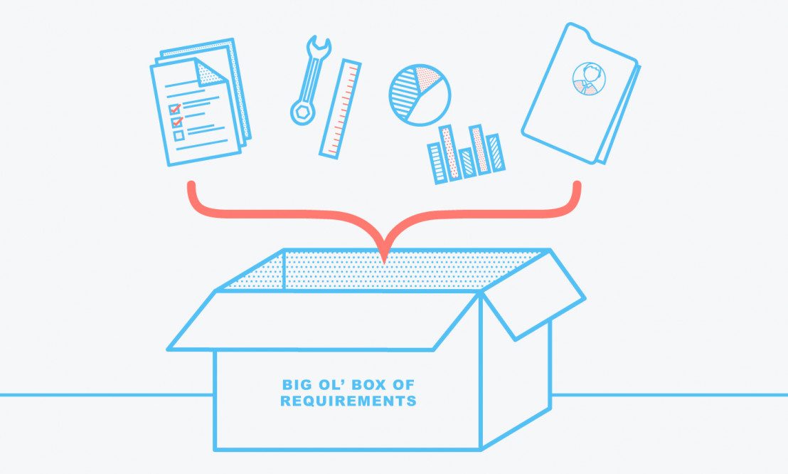




Project Scope
The plan of the project consists of majorly 5 parts:
2.Creating Data Warehouse
3.Breaking DW into Data Marts
1. Requirement Gathering
4.Creating BI Plan
5.Maintenance of DW

Slide 7
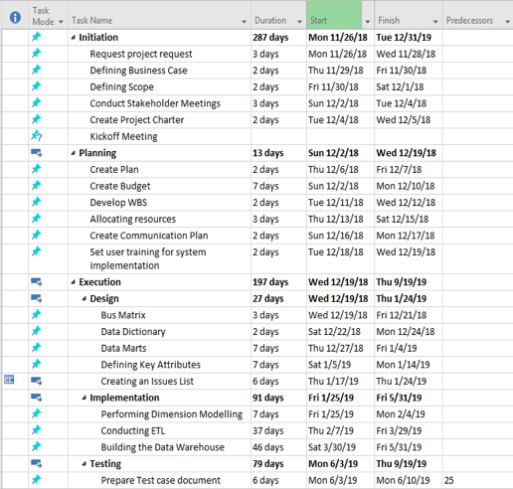
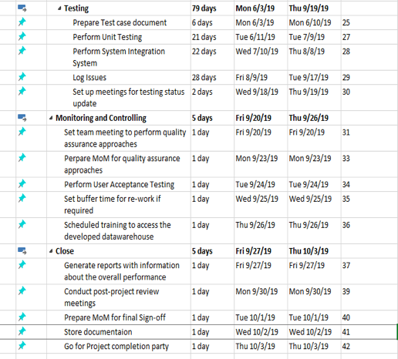
WBS

Slide 8
Estimated Cost & ROI
1.Storage:
$ 500/ month * 12 = $ 6,000 / year
2. Software:
$ 1000 / month* 12 = $ 12,000 / year
3.Human resources
$ 16,000/month (DW team of 4) * 12= $ 1,92,000 / year
•Additional Costs: $ 10,000
•Total Costs: $ 2,20,000 approximately
•Estimated ROI = Considering Company will have 5000 customers and has a growth of 10% with the implementation than i.e. 500 and minimum insurance cover is of $750 = 500 *750 = $ 3,00,000
•ROI = 70.45 %

Slide 9
Target to Source Analysis
•Identified all source and legacy systems that have data to be extracted from
•Identified valuable data and formed aggregation/summarization strategies
•Identified data types and their corresponding data types in the ETL tool used for the process
•Summarized data in such a way that valuable information is not lost, and storage costs are kept minimum

Slide 10
Business Case - 1
FudSenior management would like to track FudgeMart’s departmental sales of different products to take important business decisions to increase efficiency and drive sales.
fact_sales
Dim_products, Dim_customers

Slide 11
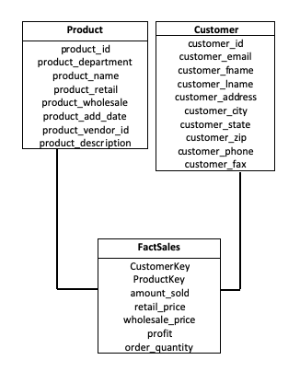
Star Schema using Product and Customer Dimension

Slide 12
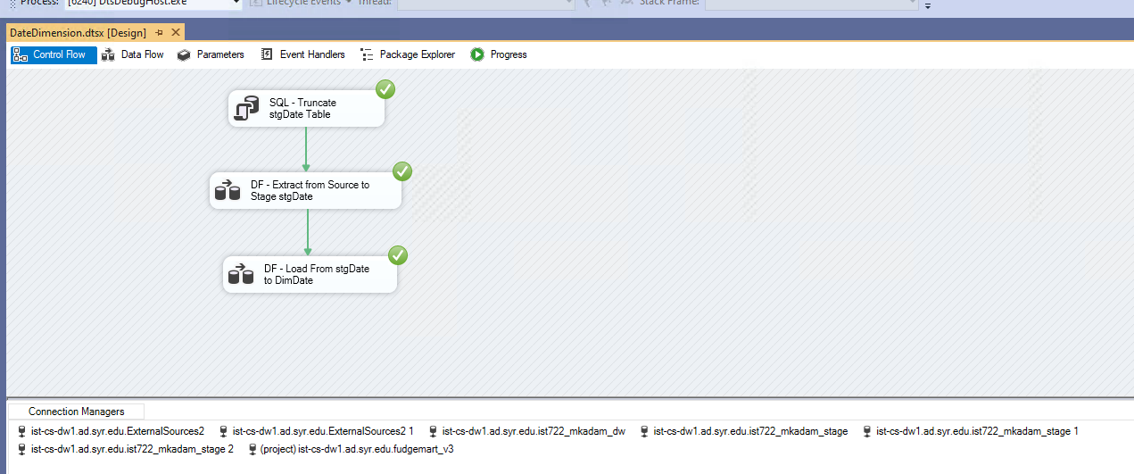
Extract - Date Dimension

Slide 13
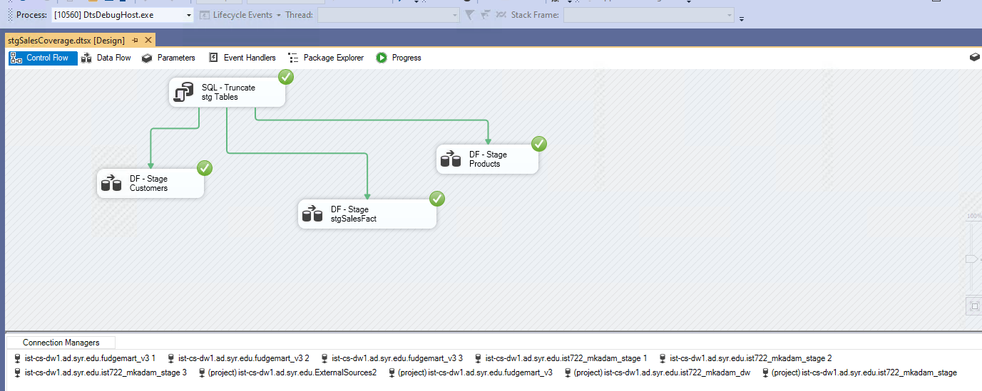
Extract - Product, Customer & SalesFact

Slide 14
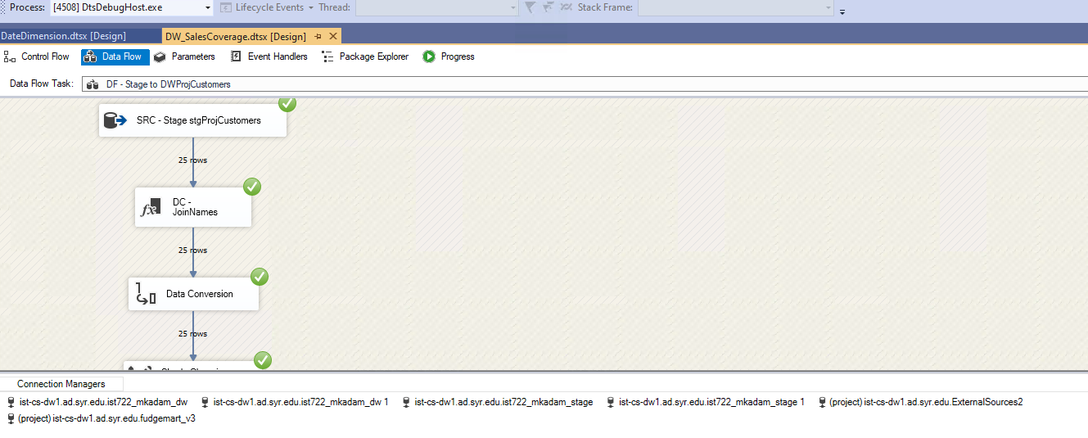
Transform - Customer Dimension

Slide 15
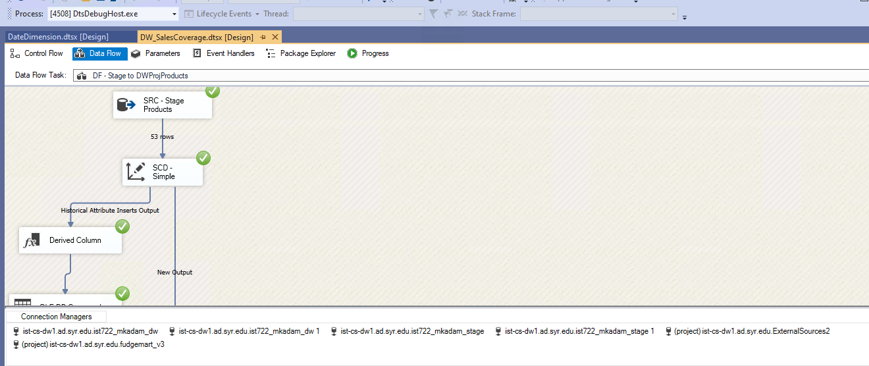
Transform - Product Dimension

Slide 16
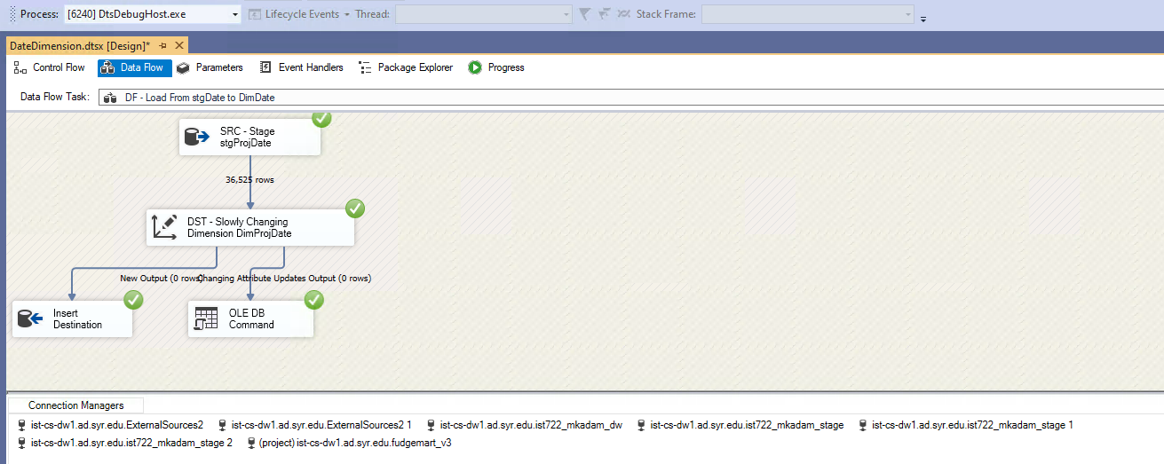
Loading - Date Dimension

Slide 17
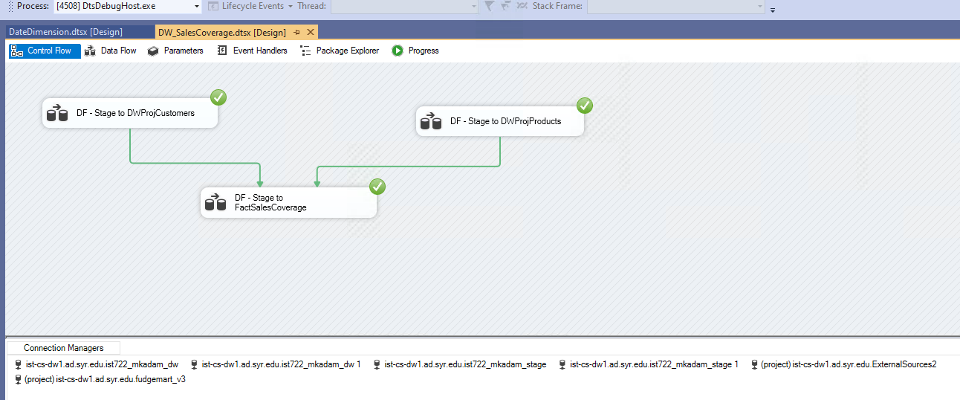
Loading - Customer, Product & FactSales

Slide 18
Business Case - 2
Identification of Loyal Customers
Management wants to monitor customer activity in both FudgeMart and FudgeFlix to determine loyal customers for target marketing
Facnt_orders
Dimensff_accounts, fm_customers, fm_orders, fm_products

Slide 19
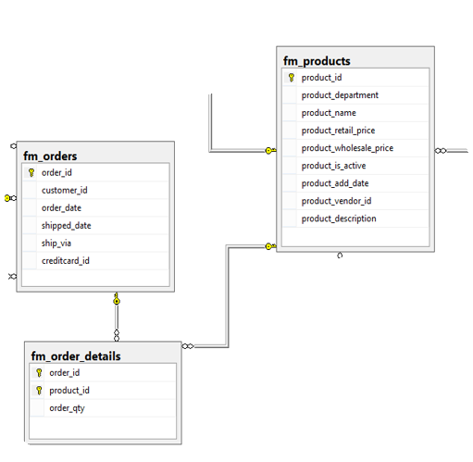
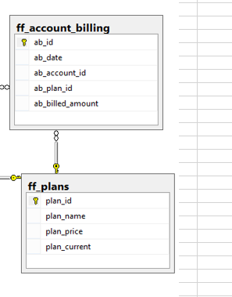
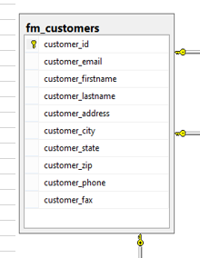
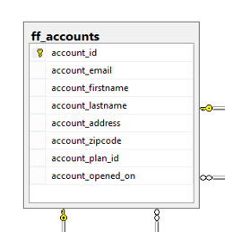
FudgeCorp - using FudgeMart & FudgeFlix
FudgeMart
FudgeFlix
FudgeMart + FudgeFlix

Slide 20
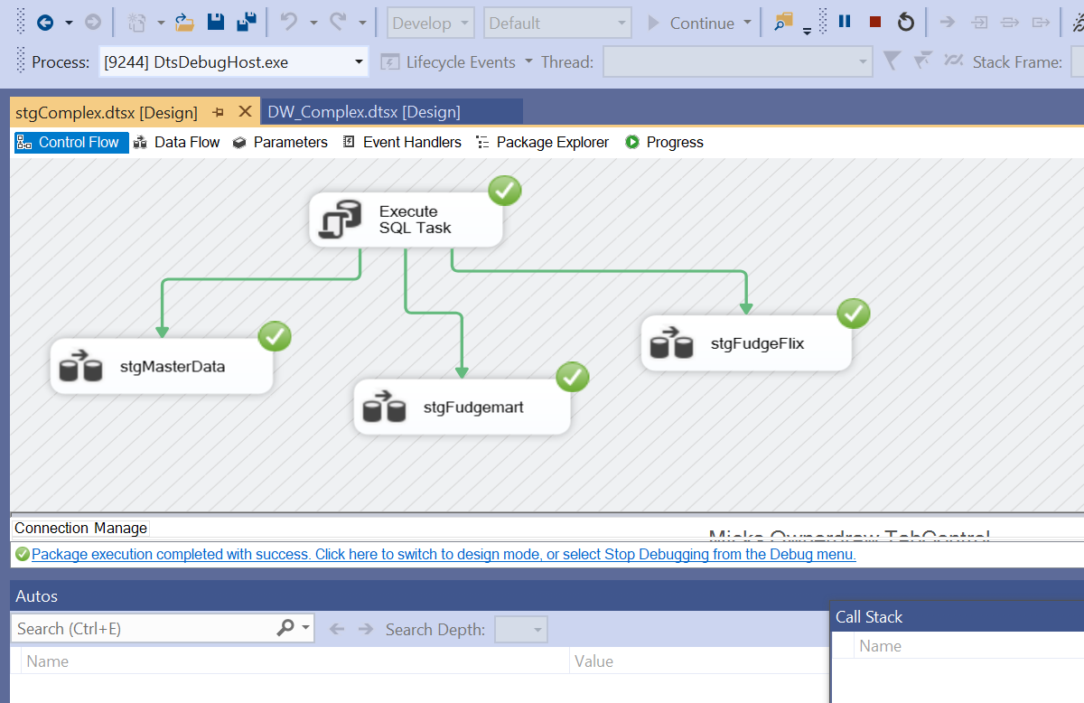
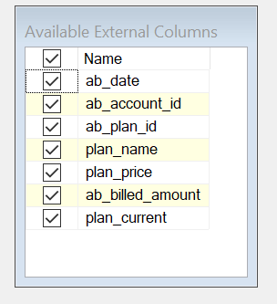
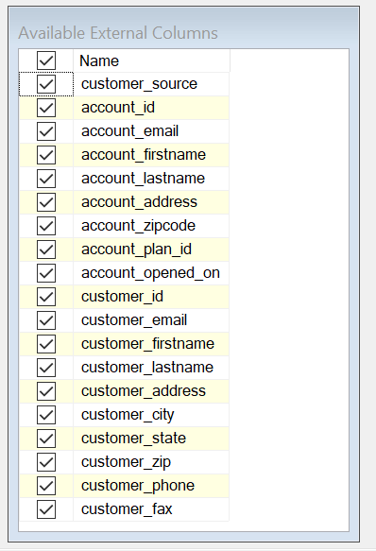
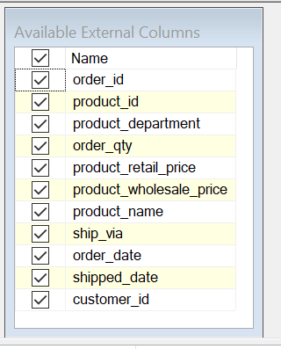
Staging data to achieve complex task

Slide 21
Loading data into the Datawarehouse
Source | CustomerID | AccountID | Order_Billed | Account_Billed
FudgeMart | 1 | Null | 56$ | Null
Both | 2 | 2 | 10$ | 90$
Both | 3 | 3 | 78$ | 10$
FudgeFlix | Null | 4 | Null | 15$
We created lookups and this is how using the staged data for the above shown we populated our DW and the FactComplex

Slide 22
Data Warehouse Maintenance Plan
Purge data: Get rid of unwanted data in the data warehouse as it is not an unlimited repository
Periodically review how the data warehouse is being used and fine tune the configuration to optimize its performance
Assign Data Loading Times into Data Warehouse
ASSIGN
Purge
Tune

Slide 23
Conclusion
The newly created Data warehouse is a summarized data coming from FundgeMart & FudgeFlix sources without loss of any valuable information which is used for better decision making and gaining insights across the FudgeCorp organization

Slide 24
Thank You!

